Slide 1

CMSC 635 Presentation #2
Janusz Slawek

Slide 2
Introduction
Scientists working with large volumes of high-dimensional data confront the problem of dimensionality reduction:
Finding meaningful low-dimensional structures hidden in a high-dimensional observations.
Classical techniques:
PCA (Principal Component Analysis), MDS (Multidimensional Scaling)
are simple to implement, efficiently computable, and guaranteed to discover the true structure of data lying on a linear subspace.

Slide 3
Existing solutions
PCA finds an embedding of the data points that best preserves their variance (recall scatter matrix).
MDS finds an embedding that preserves the inter-point distances:
The coordinate vectors y_{i} for points in new features space Y are chosen to minimize the cost function:

Slide 4
Existing solutions cont
D_{X} and D_{Y} denote the matrix of Euclidean distances between data points in X and Y and ||.||_{L2} is the L2-Norm.
The operator τ is defined by τ(D)=-HSH/2, where S is the matrix of squared distances {S_{ij}=D_{ij}²}, and H is the “centering matrix” {H_{ij}=δ_{ij}-1/N}.
Many data sets contain essential nonlinear structures that are invisible to the above methods.

Slide 5
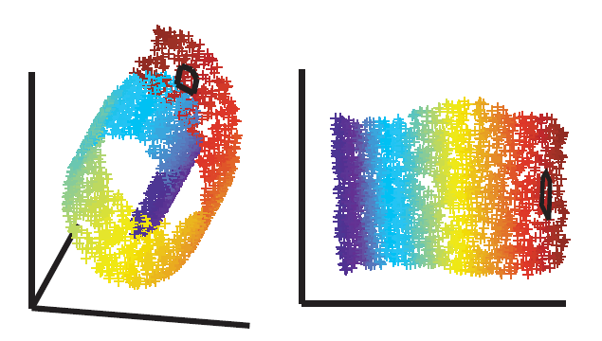
Existing solutions cont
The challenge of nonlinearity with data lying on a two-dimensional “Swiss roll”. Classical methods fail to detect the intrinsic structure.

Slide 6
Isomap
The Isomap algorithm takes as input the distances d_{X}(i,j) between all pairs i,j from N data points in the input space X:
Euclidean or domain-specific metrics
1. Construct neighborhood graph:
Define the graph G over all data points by connection points i and j if they are closer than ε (ε-Isomap), or if i is one of the K nearest neighbors of j (K-Isomap). Set edge lenghts equal to d_{x}(i,j).

Slide 7
Isomap cont
2. Compute shortest paths:
Initialize d_{G}(i,j)=d_{X}(i,j) if i,j are linked by an edge; d_{G}(i,j)=∞ otherwise. Then for each value of k=1,2,…,N in turn, replace all entries d_{G}(i,j) by min{d_{G}(i,j), d_{G}(i,k)+d_{G}(k,j)}. The matrix of final values D_{G}={d_{G}(i,j)} will contain the shortest path distances between all pairs of points in G. This procedure is known as Floyd’s algorithm, requires O(N³) operations. More efficient algorithms can be found.

Slide 8
Isomap cont
3. Construct d-dimensional embedding:
Let λ_{p} be the p-th eigenvalue (in decreasing order) of the matrix τ(D_{G}), and v_{p}^{i} be the i-th component of the p-th eigenvector. Then set the p-th component of the d-dimensional coordinate vector y_{i} equal to .

Slide 9
Isomap cont
Just as PCA and MDS are guaranteed, given sufficient data, to recover the true structure of linenar mainfolds, Isomap is guaranteed asymptotically to recover the true dimensionality and geometric structure of a strictly larger class of nonlinear mainfolds.
Guarantees of asymptotic convergence rest on a proof that as the number of data points increases, the graph distances d_{G}(i,j) provide increasingly better approximations to the real structure of the data.
Geometry of mainfolds in the high-dimensional input space may be higlhy folded, twisted, or curved.

Slide 10
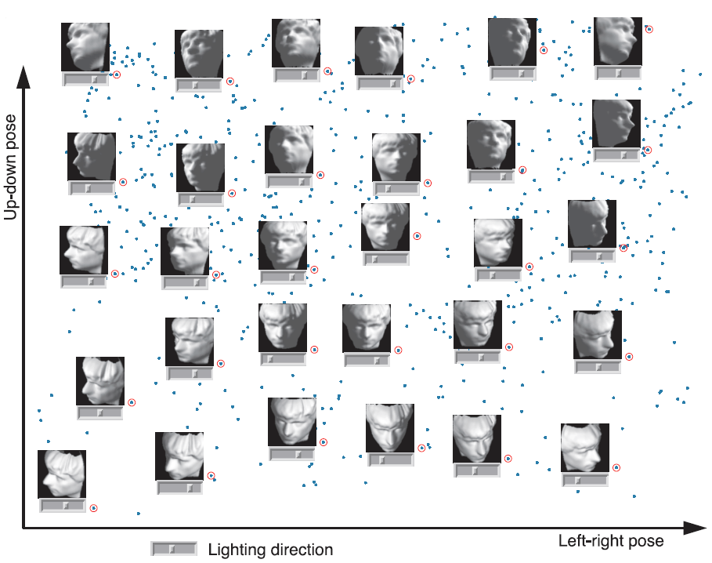
Isomap results
A canonical dimensionality reduction problem from visual perception:

Slide 11
LLE
LLE (Locally Linear Embedding):
eliminates the need to estimate pair-wise distances between widely separated data points,
Recovers global nonlinear structure from locally linear fits, expecting each data point and its neighbors to lie on locally linear patch of the mainfold.
1. Assign neighbors to each data point X_{i} (for example by using the K nearest neighbors).

Slide 12
LLE cont
2. Compute the weights W_{ij} that best linearly reconstruct X_{i} from its neighbors, solving the constrained least-squares problem:
which adds up the squared distances between all the data points and their reconstructions.

Slide 13
LLE cont
3. Compute the low-dimensional embedding vectors Y_{i} best reconstructed by W_{ij}, minimizing:
Subject to constraints that make the problem well-post, it can be minimized by solving a sparse NxN eigenvalue problem, whose bottom d nonzero eigenvectors provide an ordered set of orthogonal coordinates.

Slide 14
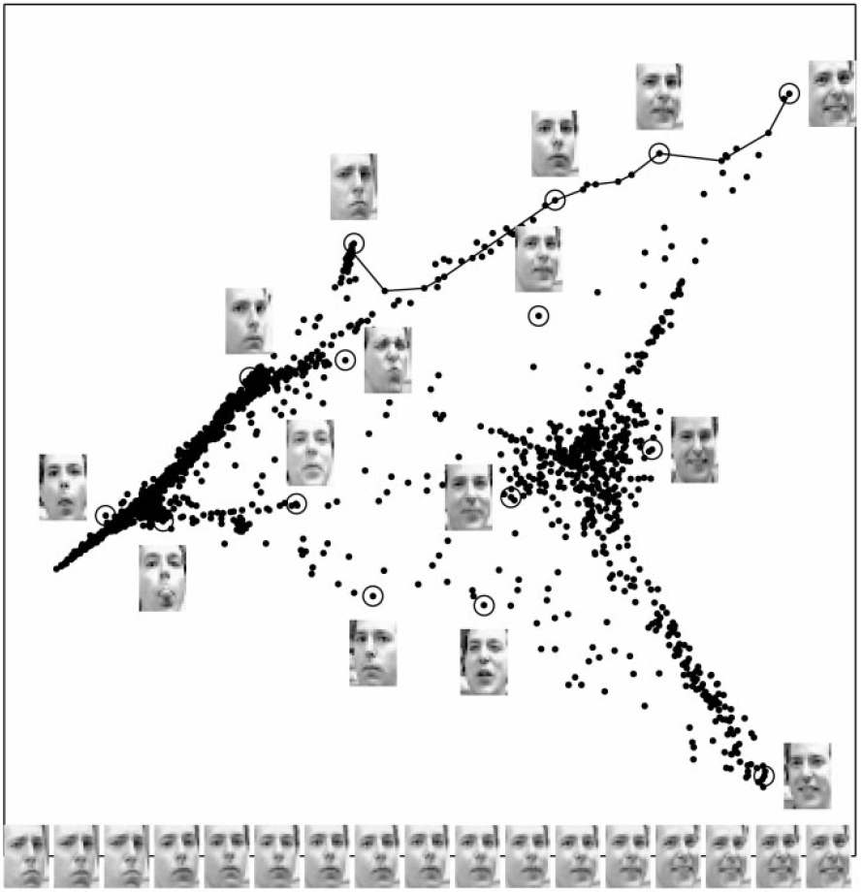
LLE results
Images of faces mapped into the embedding space described by the first two coordinates of LLE:

Slide 15
References
J. B. Tenenbaum, V. de Silva, J. C. Langford, Science 290, 2319 (2000)
S. T. Roweis, L. K. Saul, Science 290, 2323 (2000)

Slide 16

Thank you for your attention!
Questions?

